Slide 1


Big Mountain Ski Resort
Ticket Pricing Model
By Javier PEREZ
FOUNDER AND CEO
March, 06, 2024

Slide 2
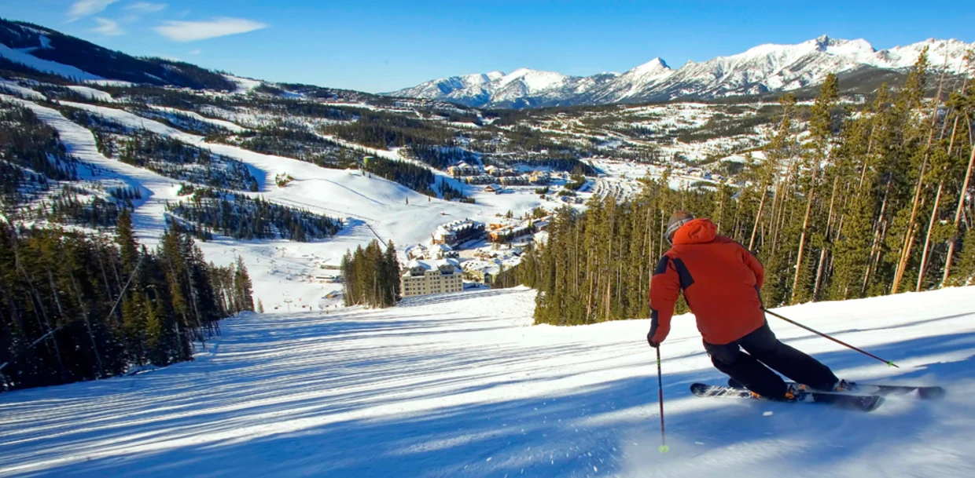

Big Mountain resort
Pricing Model Objective
The project objective was to develop a cost contingency or pricing strategy for Big Mountain to offset an additional $1,540,000 in operational costs. As well as giving advice to the resort about how to optimize ticket pricing as well as how to reduce costs without affecting prices or justify higher rates.

Slide 3

Data Science Metodology
The overall project consisted of 6 steps :
Collect, Organize, Define and Clean
Develop, Standarize and Train
Final Report, Slide Deck and Presentation
Data Wrangling
PROCESSING
DOCUMENT
1
2
3
4
5
6
Problem
eda
Modeling
Identification and Scope
Relationship
Between data and Features
Select, Train, Deploy Model and Predict Insights

Slide 4
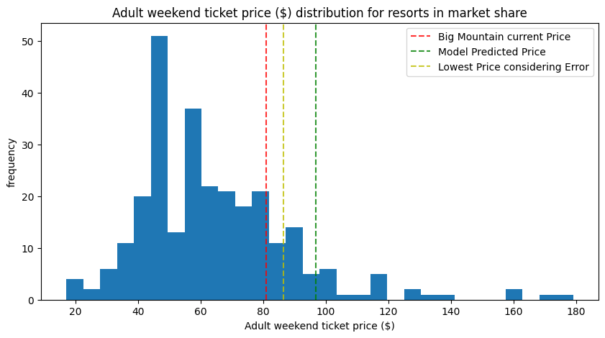
Pricing opportunities
Current vs potential Price
There is room for an increase by $5.49 USD per ticket at least. I recommend to price up as a short-term action.

Slide 5
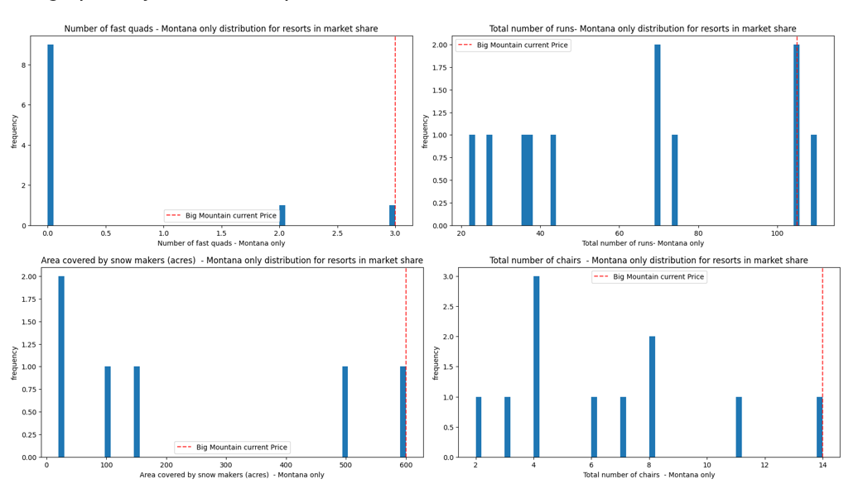
differenciation
Big mountain is leader in top 4/5 dominant features for price

Slide 6
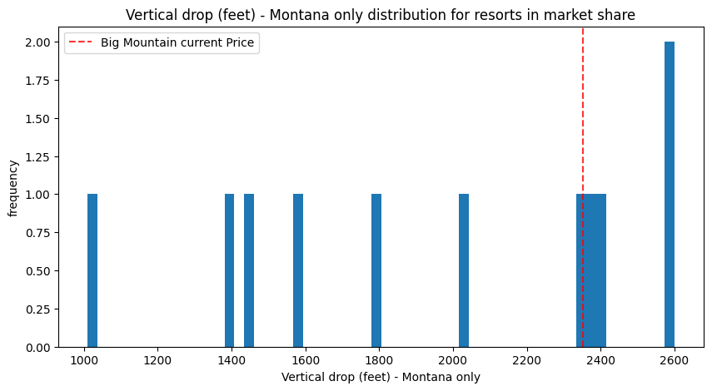
Vertical drop
Room of opportunity
Increase the vertical drop by adding a run to a point 150 feet lower down but requiring the installation of an additional chair lift to bring skiers
Sems to be the most promising as it could support ticket price by $2.97, which considering 350,000 visitors, with 5 days average would increase sales by $5.2M in a year.

Slide 7
summary Proposal
Short term & long term
ideas
Data analysis
(current stage
Eda, modeling
Premium brand market positioning
Measure effectiveness
Improve vertical drop
2nd wave of pricing
Future state

Slide 8

Thank you
Thanks for watching! Stay in touch with us!
facebook.com/gemhack
facebook.com/jjpo
twitter.com/gemhack
skype.com/javierjorge77

